Slide 1
Experimenting with different schemes for 0-N boundary condition in numerical approximation of the Laplacian on an arbitrary region
Scott Alter

Slide 2
the problem
Find a pedagogically useful way to numerically approximate the Laplacian of a function over an arbitrary 2-D region
Previous work (Neuberger, Swift, other grad students)
Order h²-accurate eigenvalues on the unit square, circle, and equilateral triangle for 0-D boundary conditions (with arbitrary region code)
Experimentation with 0-N boundary conditions, cases - h-accurate eigenvalues
h-accurate obtainable through setting Ughost = U₀ (h²-accurate on a square, experimental)

Slide 3

The quest for 0-N on an arbitrary region
Code examples
Contrived experiment for isolated testing of schemes
Always $\frac{h}{2}$ from boundary
Drawings of schemes
Complicated
Diagram
Ustar from 3-point forward 1st difference (h and $\frac{h}{2}$) and $α\left(Ux\right)+β\left(Uy\right)=0$
Simpler and just as accurate!
Derivation from $α\left(Ux\right)+β\left(Uy\right)=0$ using central 2nd difference
O(h²)! We thought…
Various tests
All good except 2nd difference…

Slide 4

2nd difference not converging to correct value
Ughost -> correct U-value O(h²)… but:
Doesn’t converge to the correct value (off by asymptotic error constant).
This means we need O(h⁴)-accurate Ug to be able to get O(h²) accurate Uxx (which implies O(h²) eigenvalues)
$Uxx≅ \frac{U_{g}−2U_{0}+U_{1}}{h^{2}}$ = $\frac{U_{g}+ah^{2}−2U_{0}+U_{1}}{h^{2}}$ = $\frac{f^{4}(ε)}{12}h^{2}+a$

Slide 5
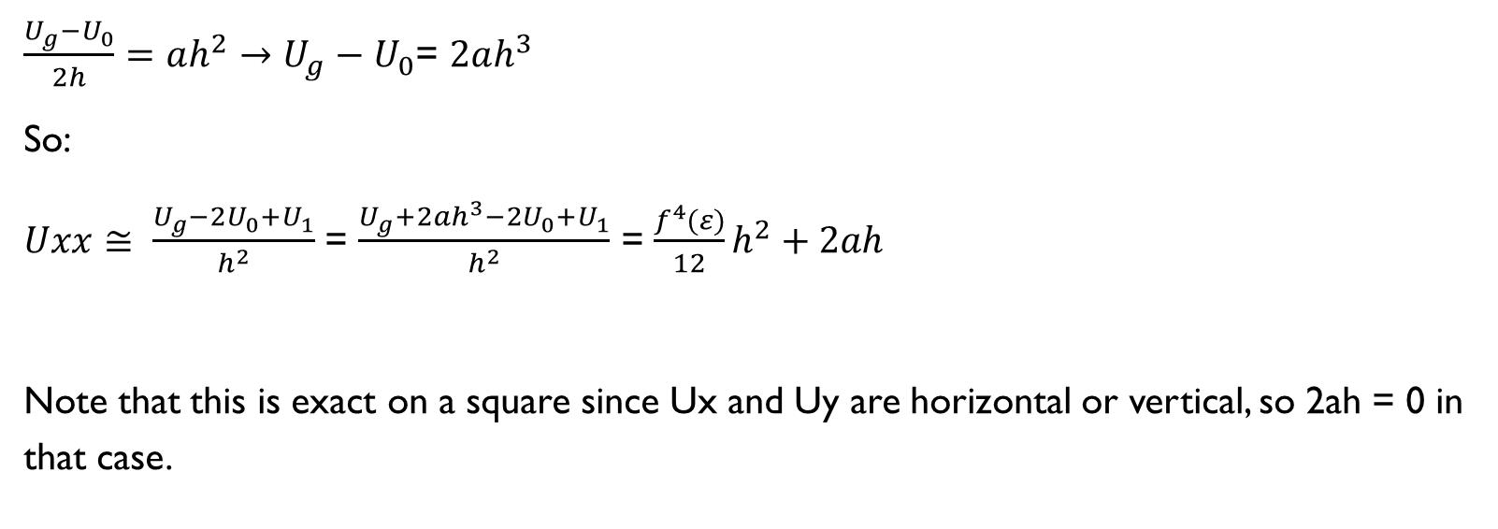
What about the experimental O(h)?
$\frac{U_{g}{−U}_{0}}{2h}=ah^{2}→U_{g}{− U}_{0}$= $2ah^{3}$
So:
$Uxx≅ \frac{U_{g}−2U_{0}+U_{1}}{h^{2}}$ = $\frac{U_{g}+2ah^{3}−2U_{0}+U_{1}}{h^{2}}$ = $\frac{f^{4}(ε)}{12}h^{2}+2ah$
Note that this is exact on a square since Ux and Uy are horizontal or vertical, so 2ah = 0 in that case.

Slide 6
A quick side note on other cases
If we drop finitely many other cases, then the convergence should still be the same for sufficient granularity.
Never got to the point where I could test this due to issues on previous slide

Slide 7
Potential schemes
Approximate Ughost via scheme 2 but with O(h⁴) approximations of Ux and Uy
Use Ughost to artificially meet the boundary condition “exactly” (up to some epsilon regardless of granularity)
Impossible!? If we are only able to approximate Ux and Uy at the boundary, the exactness achievable in 0-D cannot be done here
(Unless we take eigenfuctions as a given and calculate exact Ux and Uy, which defeats the purpose)
Use Ustar method with O(h⁴) accuracy and quartic fit to find Ughost value
Shouldn’t be any better than (1)

Slide 8
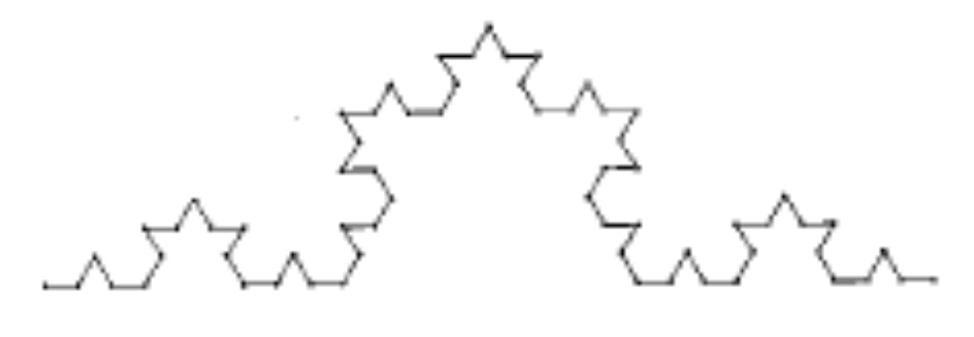
Reinvestigating 0-D
What about 0-D? Why can we get O(h²) on an arbitrary region?
Exact knowledge of distance to boundary leads to O(h²) eigenvalues for ALMOST any shape.
Scheme drawing
Counterexample
We can construct a boundary that is fractal in nature (or oscillates infinitely, or infinitely erratic)
Ex: Koch Curve
Will never converge because of shared points in concave regions
Admittedly, this isn’t particularly useful.
Applies to 0-N as well.

Slide 9
Conclusions
0-D O(h²) is obtainable on almost all shapes.
0-N O(h) is obtainable on almost all shapes.
0-N O(h²) is obtainable on regions whose edges fall on a grid.
0-N O(h²) on an arbitrary region will require O(h⁴)-accurate approximations of Ughost.

